Slide 1

Real Time UI with Apache Kafka Streaming Analytics of Fast Data and Server Push
Lucas Jellema (CTO AMIS & Oracle Developer Champion)
Oracle Code – San Francisco, October 2017
Notes:
Real Time UI with Apache Kafka Streaming Analytics of Fast Data and Server Push
Fast data arrives in real time and potentially high volume. Rapid processing, filtering and aggregation is required to ensure timely reaction and actual information in user interfaces. Doing so is a challenge, make this happen in a scalable and reliable fashion is even more interesting. This session introduces Apache Kafka as the scalable event bus that takes care of the events as they flow in and Kafka Streams for the streaming analytics. Both Java and Node applications are demonstrated that interact with Kafka and leverage Server Sent Events and WebSocket channels to update the Web UI in real time. User activity performed by the audience in the Web UI is processed by the Kafka powered back end and results in live updates on all clients.
Introducing the challenge: fast data, scalable and decoupled event handling, streaming analytics
Introduction of Kafka
demo of Producing to and consuming from Kafka in Java and Nodejs clients
Intro Kafka Stream API for streaming analytics
Demo streaming analytics from java client
Intro of web ui: HTML 5, WebSocket channel and SSE listener
Demo of Push from server to Web UI - in general
End to end flow:
- IFTTT picks up Tweets and pushed them to an API that hands them to Kafka Topic.
- The Java application Consumes these events, performs Streaming Analytics (grouped by hashtag and author and time window) and counts them; the aggregation results are produced to Kafka
- The NodeJS application consumes these aggregation results and pushes them to Web UI
- The WebUI displays the selected Tweets along with the aggregation results
- in the Web UI, users can LIKE and RATE the tweets; each like or rating is sent to the server and produced to Kafka; these events are processed too through Stream Analytics and result in updated Like counts and Average Rating results; these are then pushed to all clients; this means that the audience can Tweet, see the tweet appear in the web ui on their own device, rate & like and see the ratings and like count update in real time

Slide 2
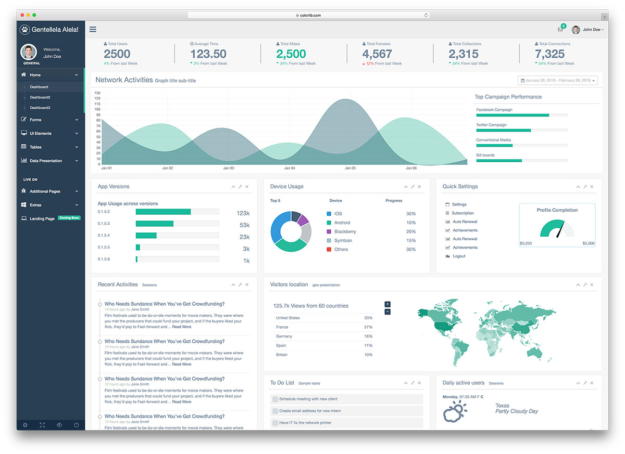

Slide 3
<F5>

Slide 4
<CTRL F5>

Slide 5
Application Server
F5
F5
F5
CTRLF5
CTRLF5
CTRLF5

Slide 6
Application Server
F5
F5
F5
CTRLF5
CTRLF5
CTRLF5

Slide 7
Application Server
F5
F5
F5
CTRLF5
CTRLF5
CTRLF5

Slide 8
Fast data and active UI
Handle influx
Publish findings instantaneously
Update UI & notify end user immediately
Analyze in real time
Decoupled components
No data loss when a component is temporarily down
Scalable with volume of events and of number of clients

Slide 9




The case at hand
Tweets on #oow17 #javaone #oraclecode
Show live tweet feed for conferences
Allow users to like tweets –and show live list of liked tweets
Client
Show live tweet aggregates per conference
Client
Show a live list of top 3 liked tweets per conference
Client
Client

Slide 10
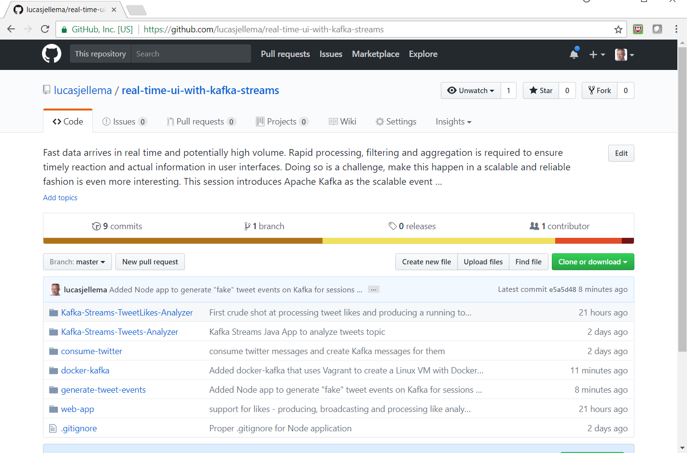
The Code
https://github.com/lucasjellema/real-time-ui-with-kafka-streams

Slide 11
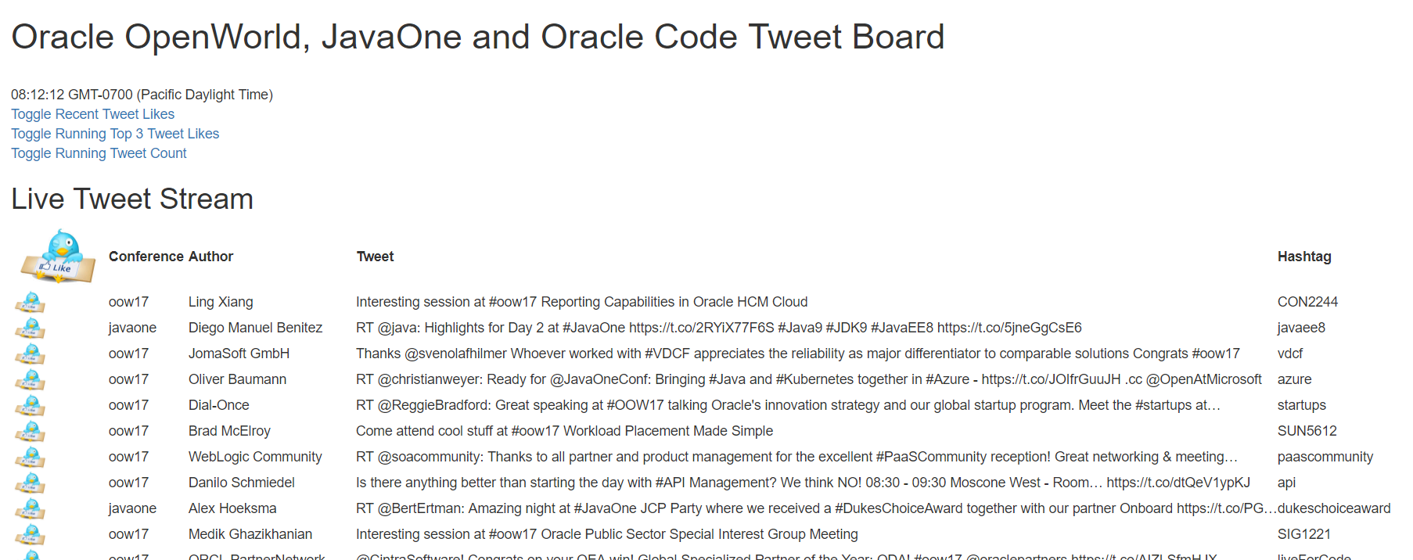
The deo
http://tinyurl.com/kafkaui

Slide 12
Events
Consumers
Producers
Robust, Scalable, History Retention
Containerized/Cloud-enabled

Slide 13
Requirements for Event capability
Provide decoupling between publisher and consumer
Generally accessible for all consumers
Using standardized protocols and formats for communications and event payload (http, JSON)
Scalable (handle high loads)
Available (allow speedy event publication)
Reliable (do not lose events, at least once delivery)
Event Ordering (deliver events in the order of publication)
Manageable at scale
Retain Event History
For consumers that are late to the game
To construct state from all historic events: Event Sourcing

Slide 14


Introducing Apache Kafka
..- 2010 – creation at Linkedin
Message Bus | Event Broker
High volume, low latency, highly reliable, cross technology
Scalable, distributed, strict message ordering, ….
2011/2012 – open source under the Apache Incubator/ Top Project
Kafka is used by many large corporations:
Walmart, Cisco, Netflix, PayPal, LinkedIn, eBay, Spotify, Uber, Sift Science
And embraced by many software vendors & cloud providers
Client libraries available for NodeJS, Java, C++, Python, Ruby, PHP and many more

Slide 15
Kafka terminology
Message
Topic
partition
Message
== ByteArray
Broker
replicated
Producer
Consumer
Working together in Consumer Groups
Key
Value
Time
Producer
Consumer
Broker
Topic

Slide 16



Consumers
tcp
Producers
tcp
Broker
Topic

Slide 17
Kafka incarnations
Kafka Docker Images
Confluent (Spotify, Wurstmeister)
Cloud:
CloudKarafka
Oracle Event Hub
IBM BlueMix Message Hub
AWS supports Kafka (but tries to propose Amazon Kinesis Streams)
Google runs Kafka (though tries to push Google Pub/Sub)
Bitnami VMs for many cloud providers such as Azure, GCP, AWS, OPC
Kafka Connectors in many platforms
Azure IoT Hub, Google Pub/Sub, Mule AnyPoint Connector, …
Notes:
http://stackoverflow.com/questions/35861501/kafka-in-docker-not-working
Docker images from Confluent: https://hub.docker.com/r/confluent/kafka/

Slide 18

The case at hand – step one
Tweets on #oow17 #javaone #oraclecode
Tweets
Topic
Show live tweet feed for conferences
Client
Client
Client
Client

Slide 19


The case at hand – step one and a half
Tweets on #oow17 #javaone #oraclecode
Tweets
Topic
Show live tweet feed for conferences
Client
Client
Client
Client

Slide 20
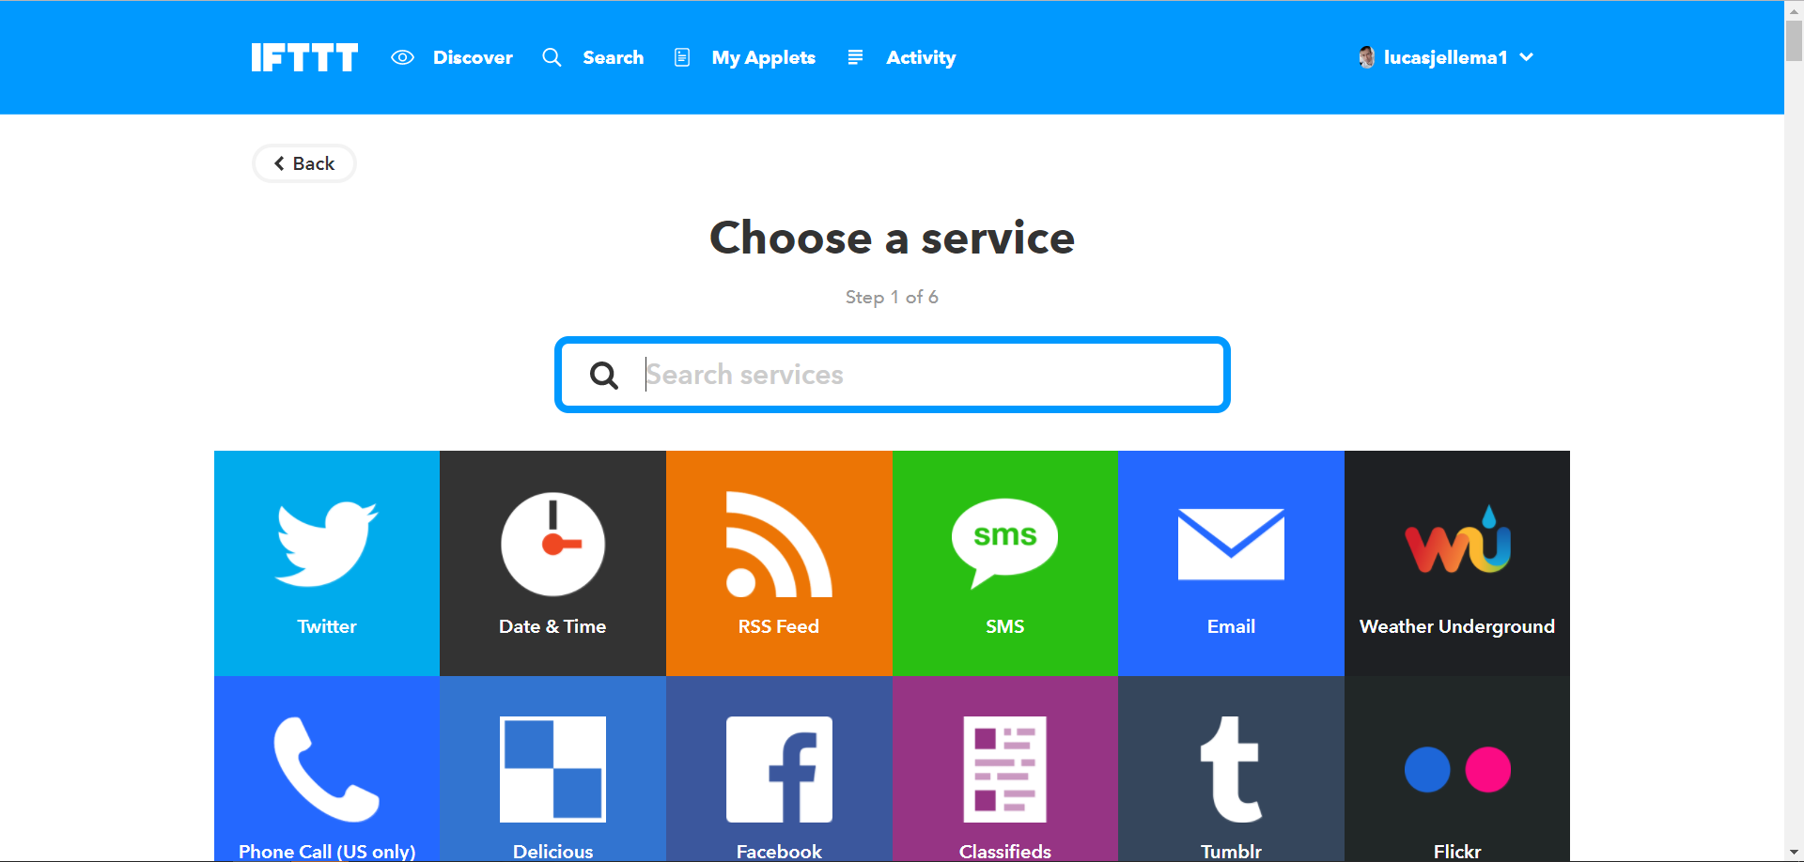
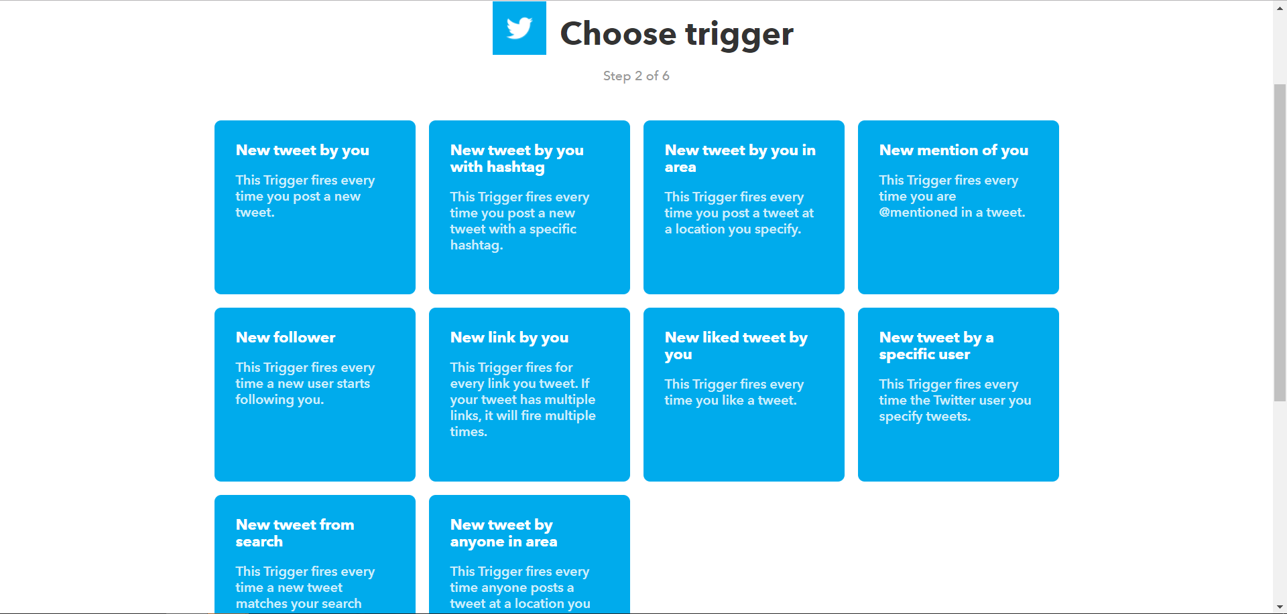
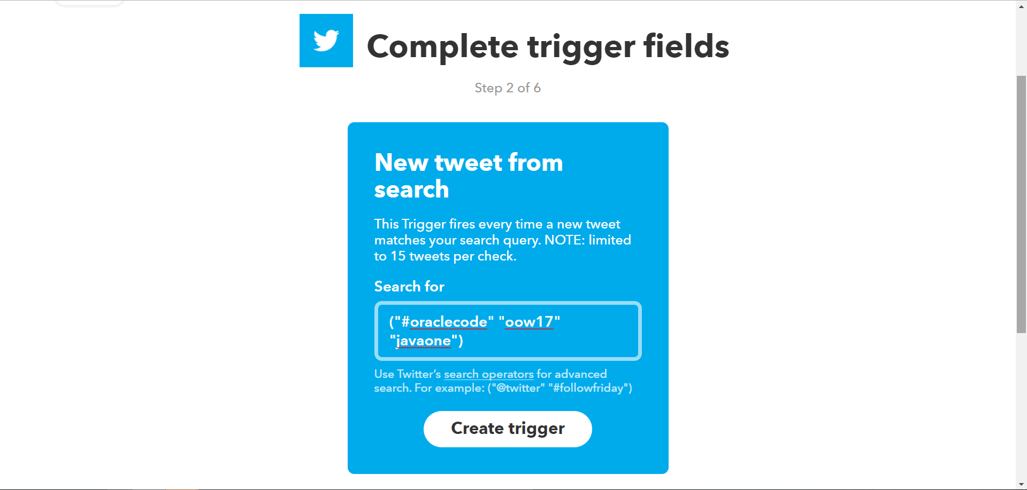
Configure IFTTT recipe

Slide 21

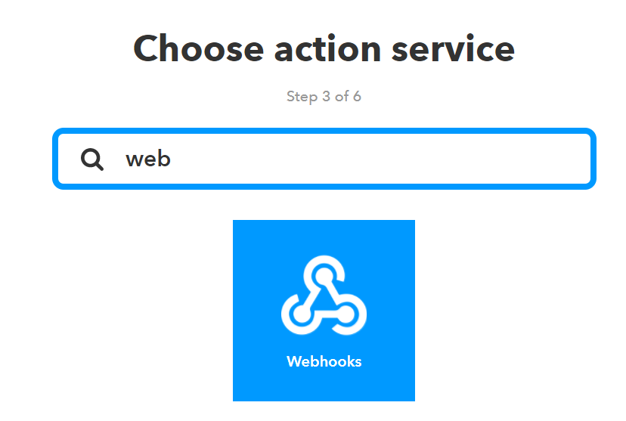
Configure IFTTT recipe

Slide 22
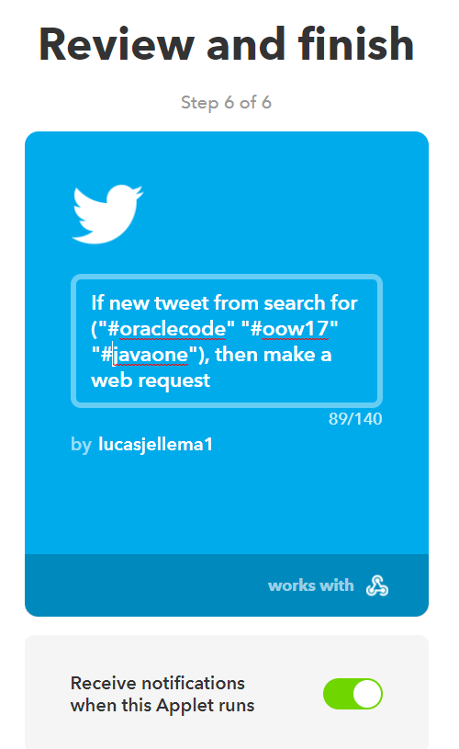
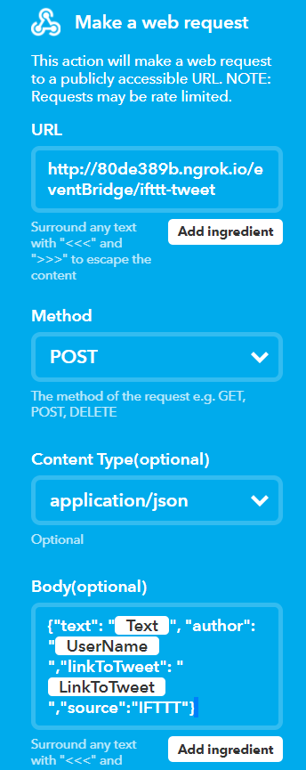
Configure IFTTT recipe

Slide 23
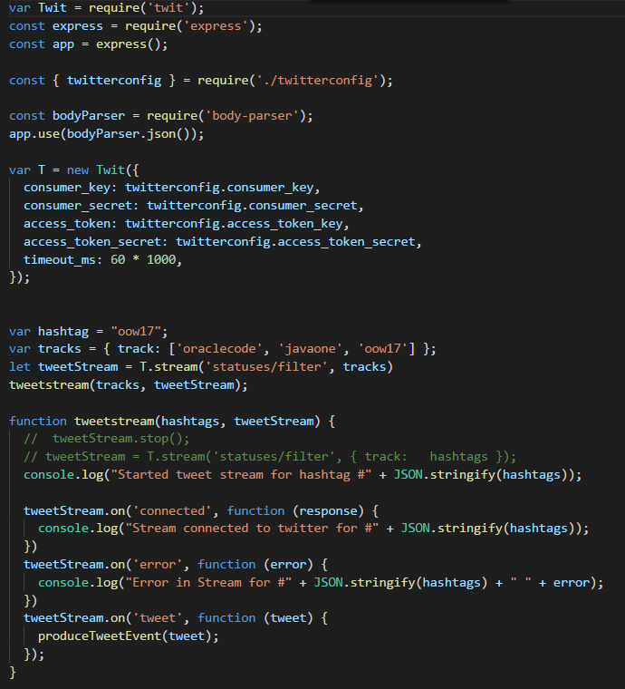
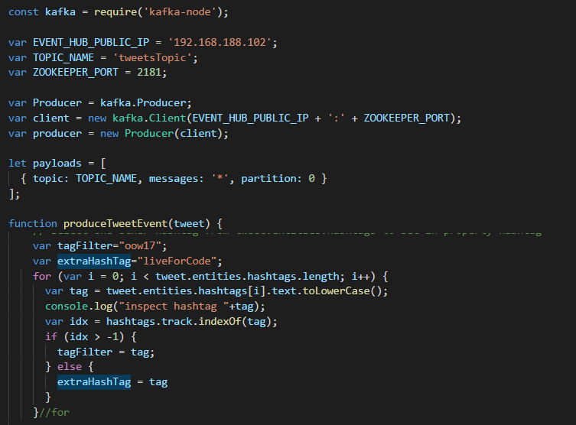
High Code approach

Slide 24
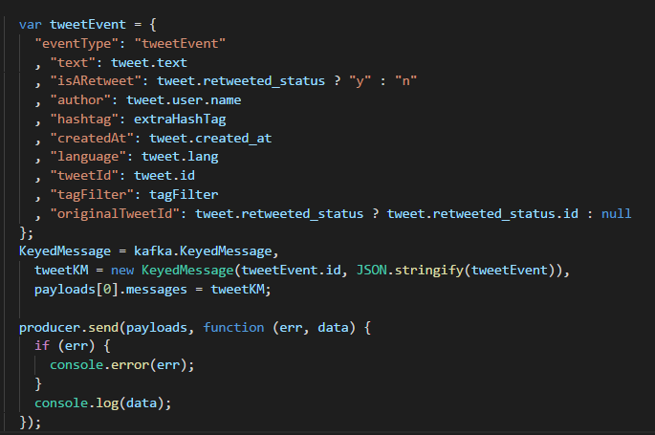
High code (2) – produce message to Kafka

Slide 25

The case at hand – step one and two
Tweets on #oow17 #javaone #oraclecode
Tweets
Topic
Show live tweet feed for conferences
Client
Client
Client
Client

Slide 26
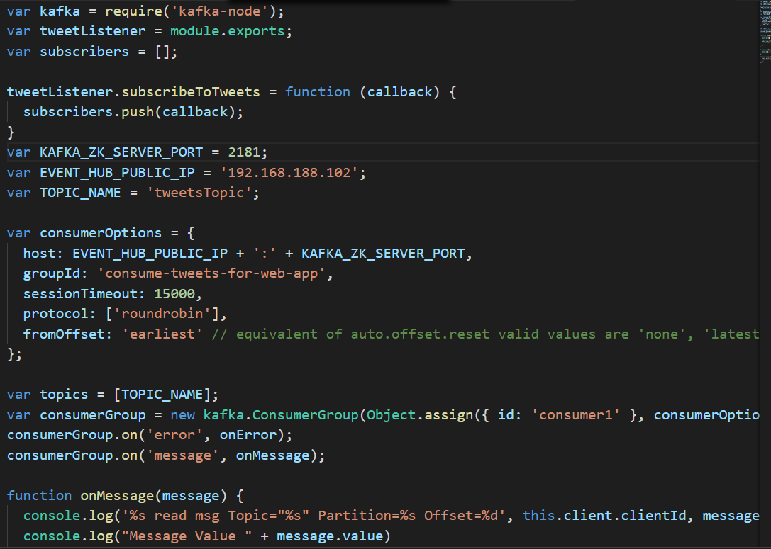
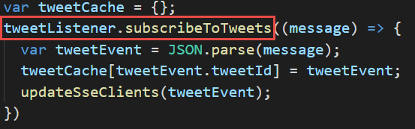
Kafka consumer in node get events pushed into application

Slide 27
The case at hand Server sent events for push back
Tweets on #oow17 #javaone #oraclecode
Tweets
Topic
Show live tweet feed for conferences
Client
Client
Server Sent Event
Client
Client

Slide 28
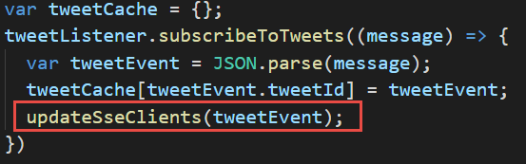
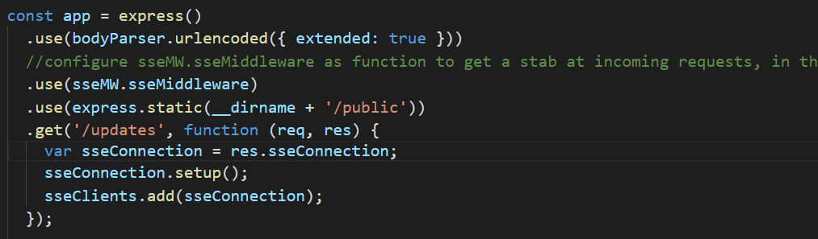
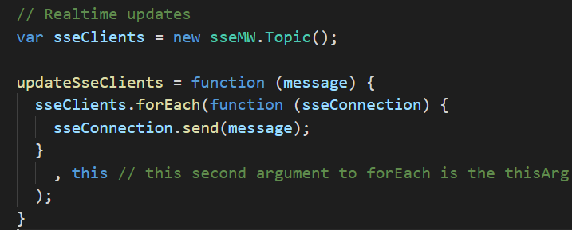
Server sent event – server side

Slide 29
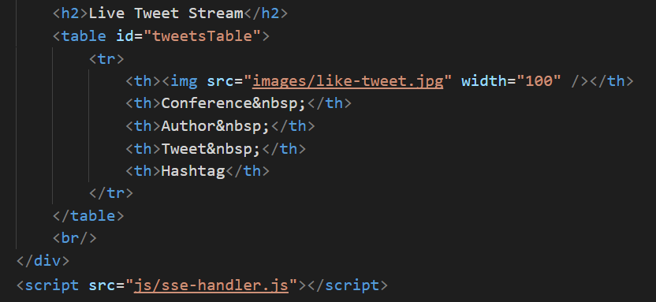
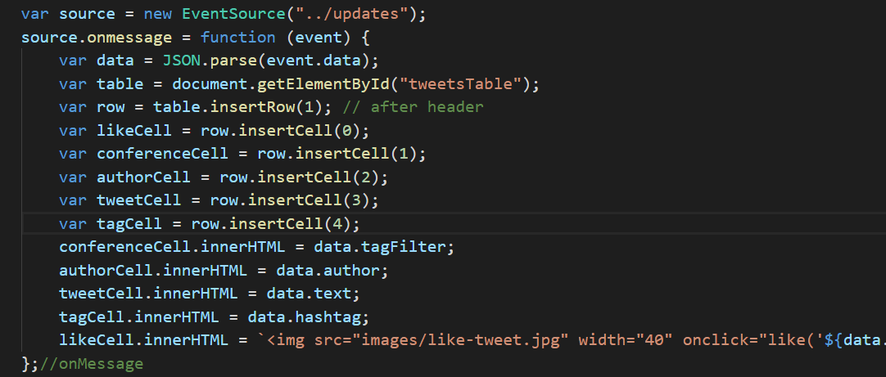
Server sent event – Client side

Slide 30
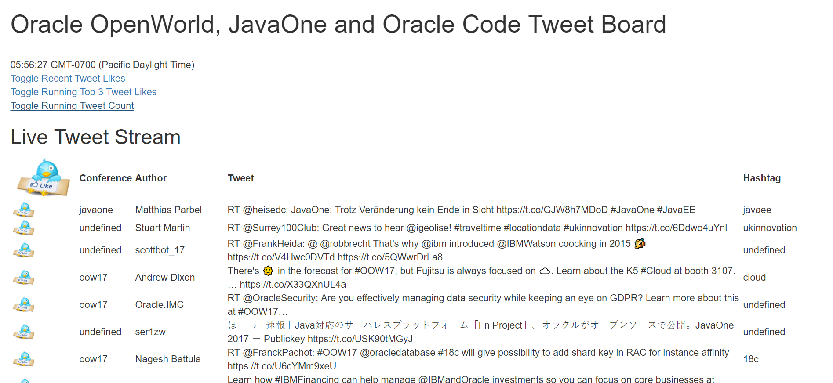
Live tweet stream
Server Sent Event

Slide 31

The case at hand Tweet Likes – client to server to all clients
Tweets on #oow17 #javaone #oraclecode
Tweets
Topic
Show live tweet feed for conferences
Allow users to like tweets –and show live list of liked tweets
Client
Client
SSE
Client
Client

Slide 32
The case at hand Web sockets – for bi directional push
Tweets on #oow17 #javaone #oraclecode
Tweets
Topic
Show live tweet feed for conferences
Allow users to like tweets –and show live list of liked tweets
Client
Client
WebSockets
SSE
Client
Client

Slide 33
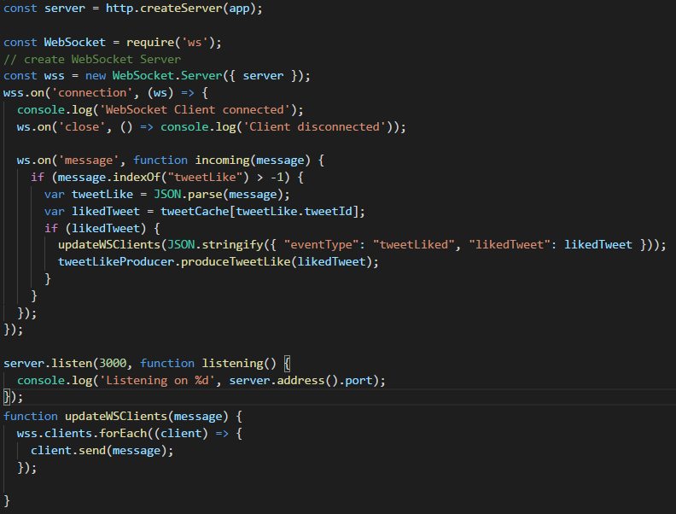
Websockets – server side

Slide 34
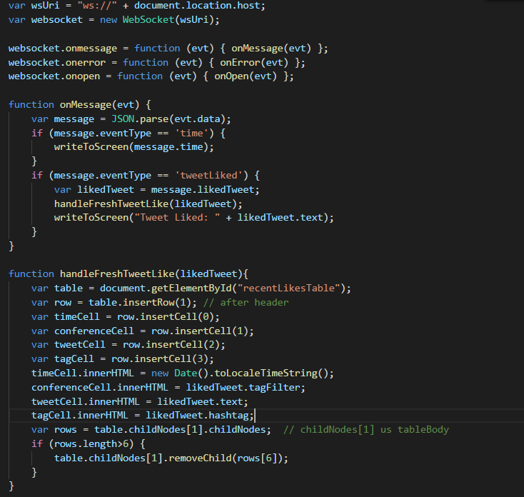
Websockets – Client side

Slide 35
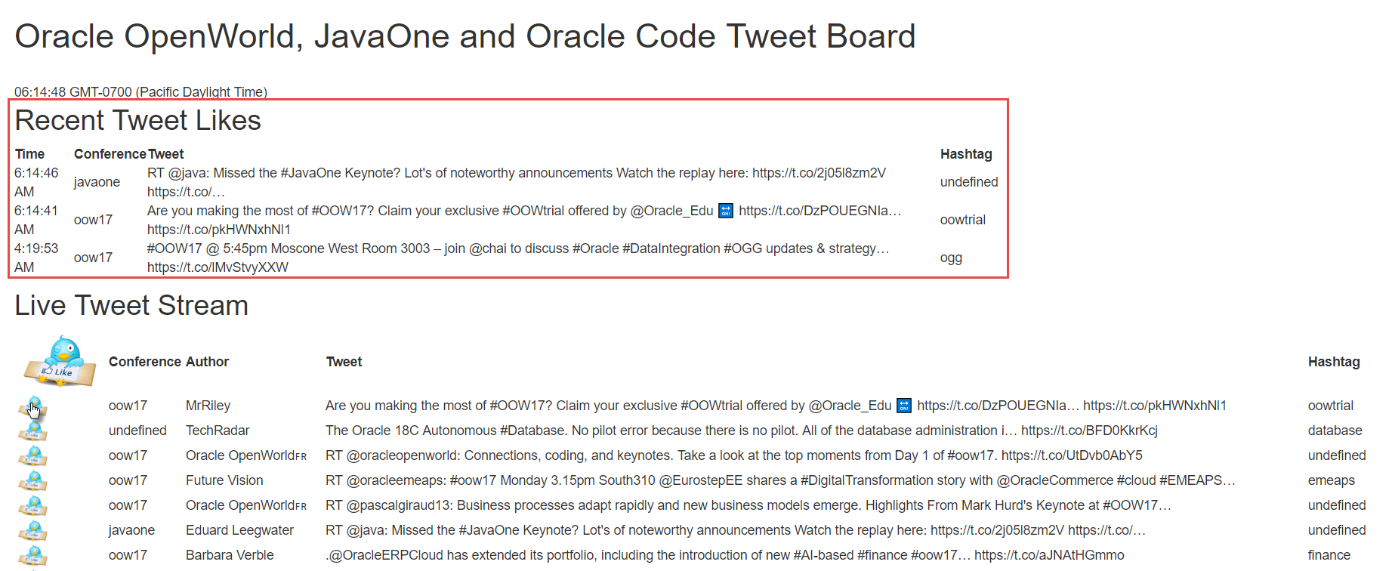
Tweet likes broadcasting
WebSockets
WebSockets

Slide 36
The case at hand Streaming analysis of tweet events
Tweets on #oow17 #javaone #oraclecode
Show live tweet feed for conferences
Tweets
Topic
Allow users to like tweets –and show live list of liked tweets
Show live tweet aggregates per conference
Client
Client
WebSockets
SSE
Client
Client

Slide 37

The case at hand - Streaming analysis of Tweets
Tweets on #oow17 #javaone #oraclecode
Show live tweet feed for conferences
Tweets
Topic
tweetAnalytics Topic
Allow users to like tweets –and show live list of liked tweets
Show live tweet aggregates per conference
Streaming Tweets Aggregation
Client
µ
Client
WebSockets
SSE
Client
Client

Slide 38
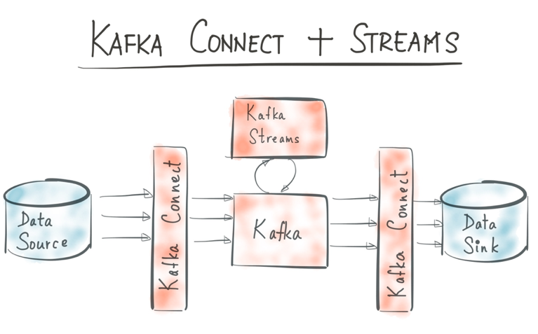
Kafka streams
Real Time Event [Stream] Processing integrated into Kafka
Aggregations & Top-N
Time Windows
Continuous Queries
Latest State (event sourcing)
Turn Stream (of changes) into Table (of most recent or current state)
Part of the state can be quite old
A Kafka Streams client will have state in memory
Always to be recreated from topic partition log files
Note: Kafka Streams is relatively new
Only support for Java clients

Slide 39
Kafka streams
Topic
Filter
Aggregate
Topic
Join
Map (Xform)
Topic
Publish

Slide 40
Example of Kafka streams
Topic
Set Conference as key
groupBy
Sum/Avg/Top3 by key (==conference)
TweetMessage
Conference
Text
Author
Hastag
Aggregate
and possibly per time window
Topic
Join
Latest Conference Details
Round aggregate to nearest 100
Map (Xform)
As JSON
Publish
Topic: CountTweetsPerConference

Slide 41
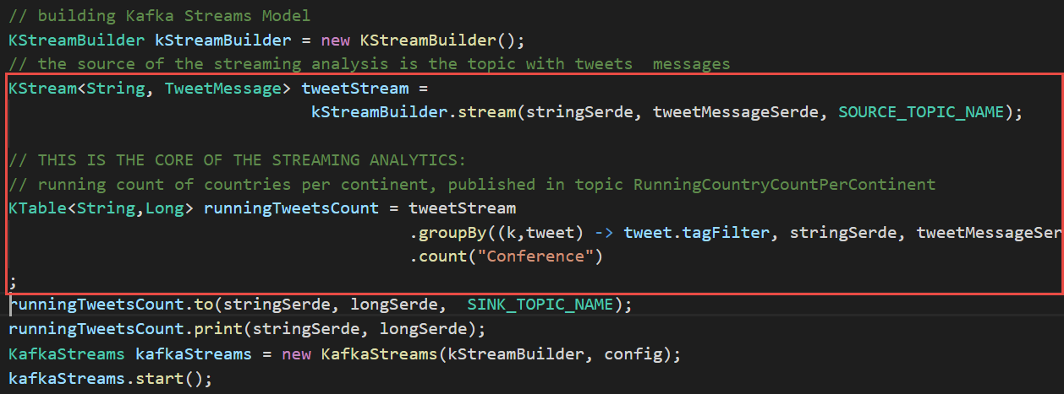
Kafka streams – running count tweets per conference

Slide 42
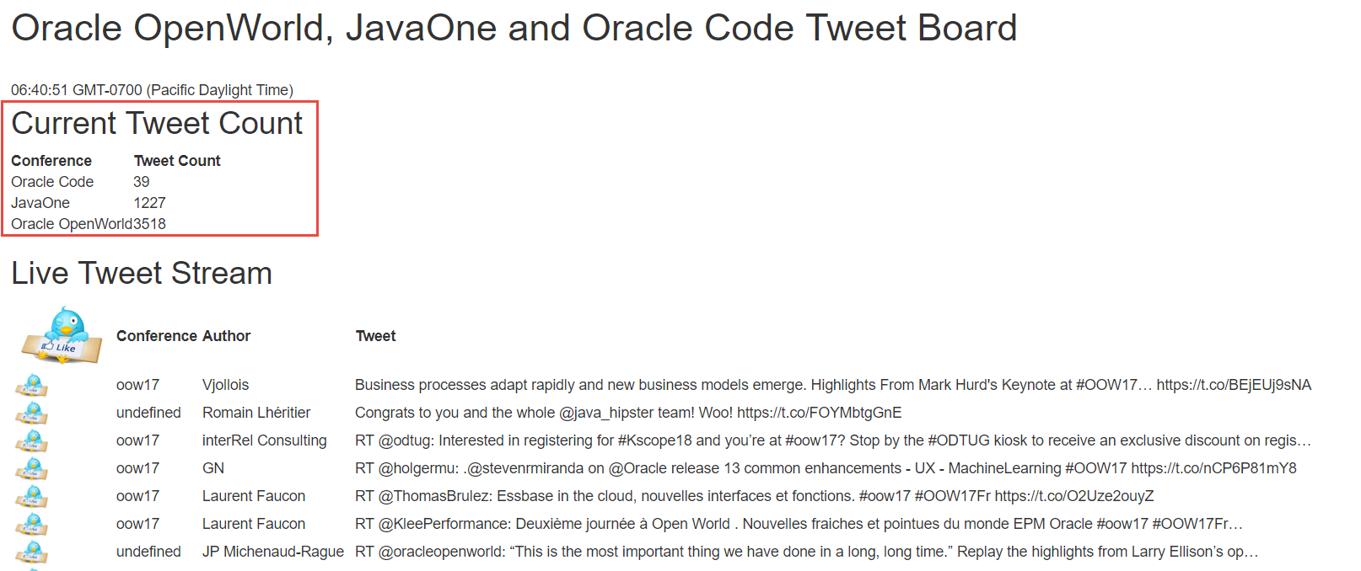
Streaming tweet analytics pushed to clients
Server Sent Event

Slide 43
The case at hand - Streaming analysis of Tweet likes
Tweets on #oow17 #javaone #oraclecode
Show live tweet feed for conferences
Allow users to like tweets –and show live list of liked tweets
Tweets
Topic
tweetAnalytics Topic
Show live tweet aggregates per conference
Show a live list of top 3 liked tweets per conference
Streaming Tweets Aggregation
Client
µ
Client
WebSockets
SSE
Client
Client

Slide 44
The case at hand - Streaming analysis of Tweet likes
Tweets on #oow17 #javaone #oraclecode
tweetLike Topic
Show live tweet feed for conferences
Allow users to like tweets –and show live list of liked tweets
Tweets
Topic
tweetAnalytics Topic
Top3TweetLikes PerConference
Show live tweet aggregates per conference
Show a live list of top 3 liked tweets per conference
Streaming Tweets Aggregation
Client
µ
Client
WebSockets
Likes
Aggregation
µ
SSE
Client
Client

Slide 45
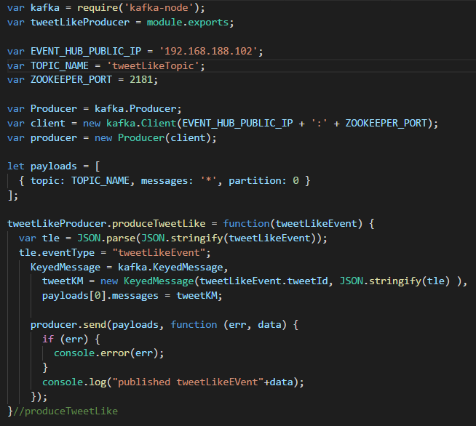
Websockets – server side

Slide 46
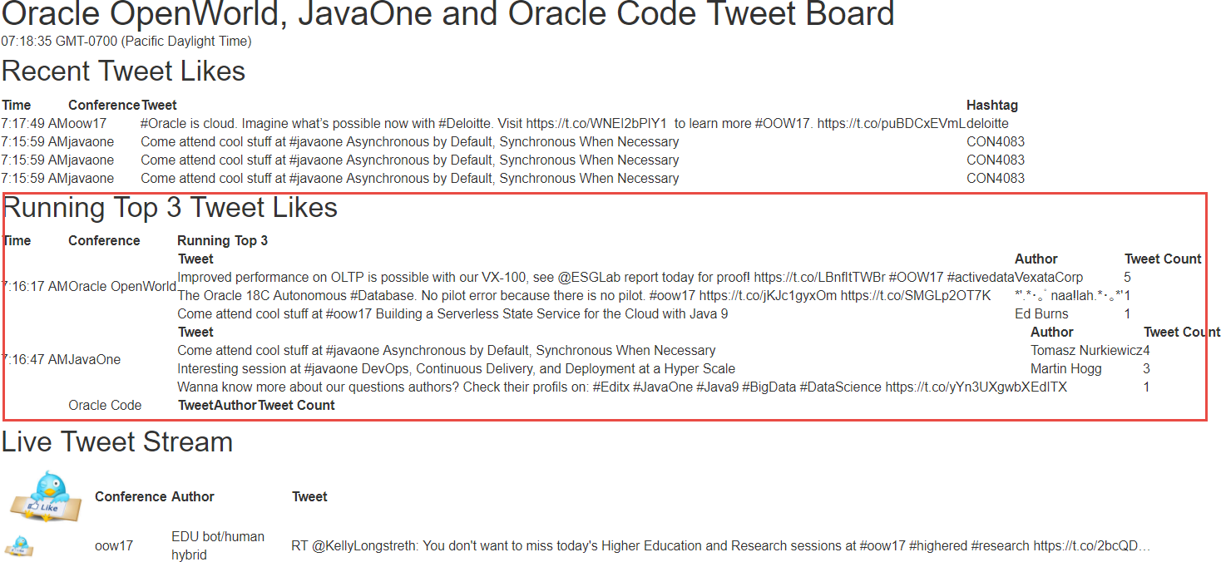
Running Top 3 of best liked tweets per conference
Server Sent Event

Slide 47

End to end flow Cloud Enabled
Cache
EventHub CS
API
µ
API
Tweets
Likes
Tweet Count
Likes Top3
µ
Client
Chrome
UI
µ
Tweets Aggregation
Likes
Aggregation
Client
Firefox
µ
µ

Slide 48
Conclusion
Fast data – Active UI
Decoupled processing
And distributed across clouds and on premises
Kafka
Events & Data Store
Streaming Analysis
Modern browser – push capability
SSE, WebSocket, HTTP/2, WebWorker Notifications
Active UI with fresh data without burden on application server and back end system
“Step away from that F5 key”

Slide 49



Blog: technology.amis.nl
Email: lucas.jellema@amis.nl
: lucasjellema
: lucas-jellema
: www.amis.nl, info@amis.nl +31 306016000 Edisonbaan 15, Nieuwegein

